Slide 1
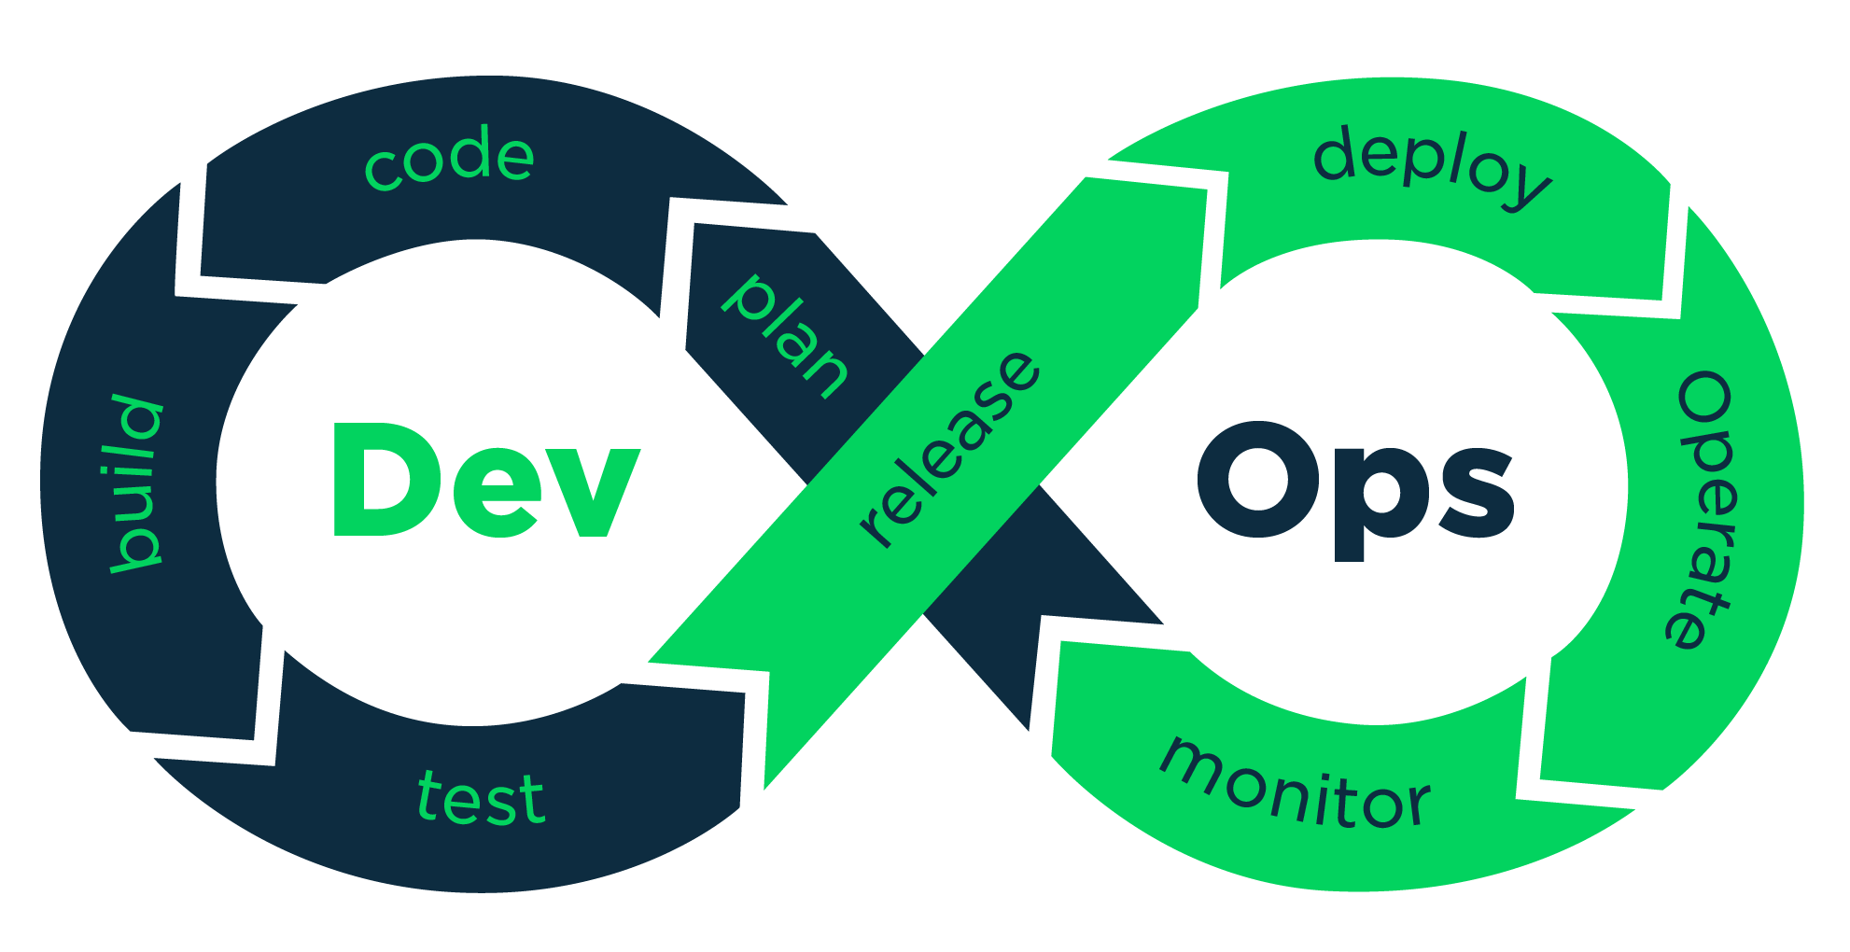


GIT Version Control
Presented by: Muhammad Anees ur Rehman | Manager DevOps

Slide 2
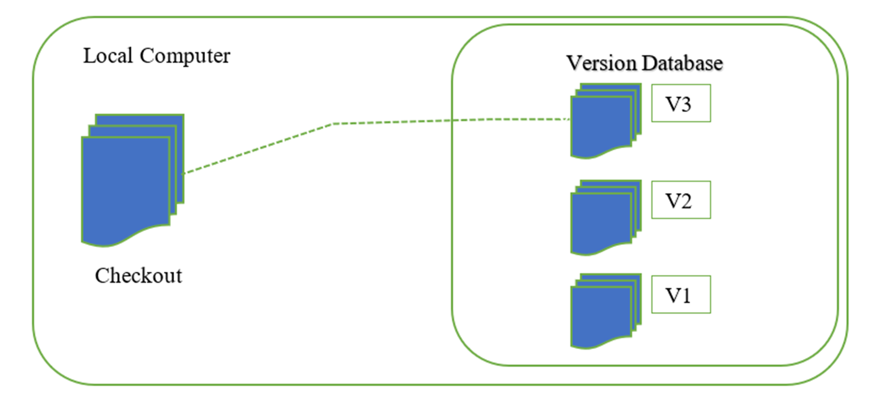
Version Control
Version control (or revision control, or source control) that automatically maintains a record of every change in a files or a set of files that you can recall specific versions later.
Local Version Control
Copy files into another directory
Developed local VCSs

Slide 3
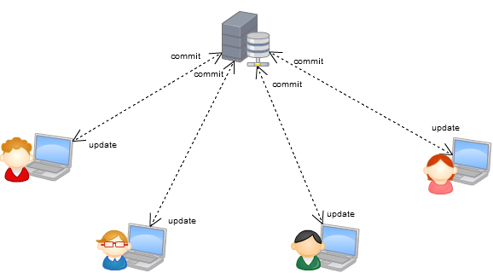
Centralized Version Control - CVC
TFS & T FVC !=
Team Foundation Version Control is a Centralized version control system, here team member has only one file on the machine and Historical data is maintained on the main server.
Developers commit their changes directly to the main server repository.
Notes:
CVS, Perforce, SVN and TFVC
Offers full visibility
Decreases the learning curve
Strong communication and collaboration are important to ensure a centralized workflow is success
Single point of failure
Repository-Scoped & Path independent branches (very small size)
TFVC: Every branch is a complete copy of your project together with all of it’s dependencies.
Slow speed delays development: users must communicate with the remote server for every command, which slows down code development.
Few stable moments to push changes: When multiple developers want to work on the same piece of code, it becomes difficult to find a stable moment to push changes.

Slide 4
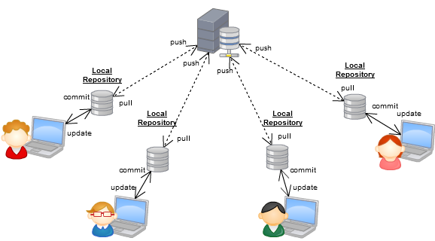
Distributed Version Control - DVC
In DVCS, every contributor has a local copy or “clone” of the main repository i.e. everyone maintains a local repository of their own which contains all the files and metadata present in the main repository
Notes:
Github VS Git
Git branches are just pointers to a commit instead of a copy of your whole project.
Git Has Integrity
Everything in Git is checksummed before it is stored and is then referred to by that checksum. This means it’s impossible to change the contents of any file or directory without Git knowing about it. SHA-1 hash [40-character string composed of hexadecimal characters (0–9 and a–f) ]

Slide 5
DVC
Speed
Simple design
Strong support for non-linear development (thousands of parallel branches)
Fully distributed
Able to handle large projects like the Linux kernel efficiently (speed and data size)
Notes:
Snapshots, Not Differences
Conceptually, most other systems store information as a list of file-based changes.
These systems (CVC and DVC) think of the information they store as a set of files and the changes made to each file over time (this is commonly described as delta-based version control). With Git, every time you commit, or save the state of your project, Git basically takes a picture of what all your files look like at that moment and stores a reference to that snapshot. if files have not changed, Git doesn’t store the file again, just a link to the previous identical file it has already stored.
Nearly Every Operation Is Local
Everything in Git is checksummed before it is stored and is then referred to by that checksum (SHA-1 hash) This is a 40-character string composed of hexadecimal characters (0–9 and a–f) a

Slide 6
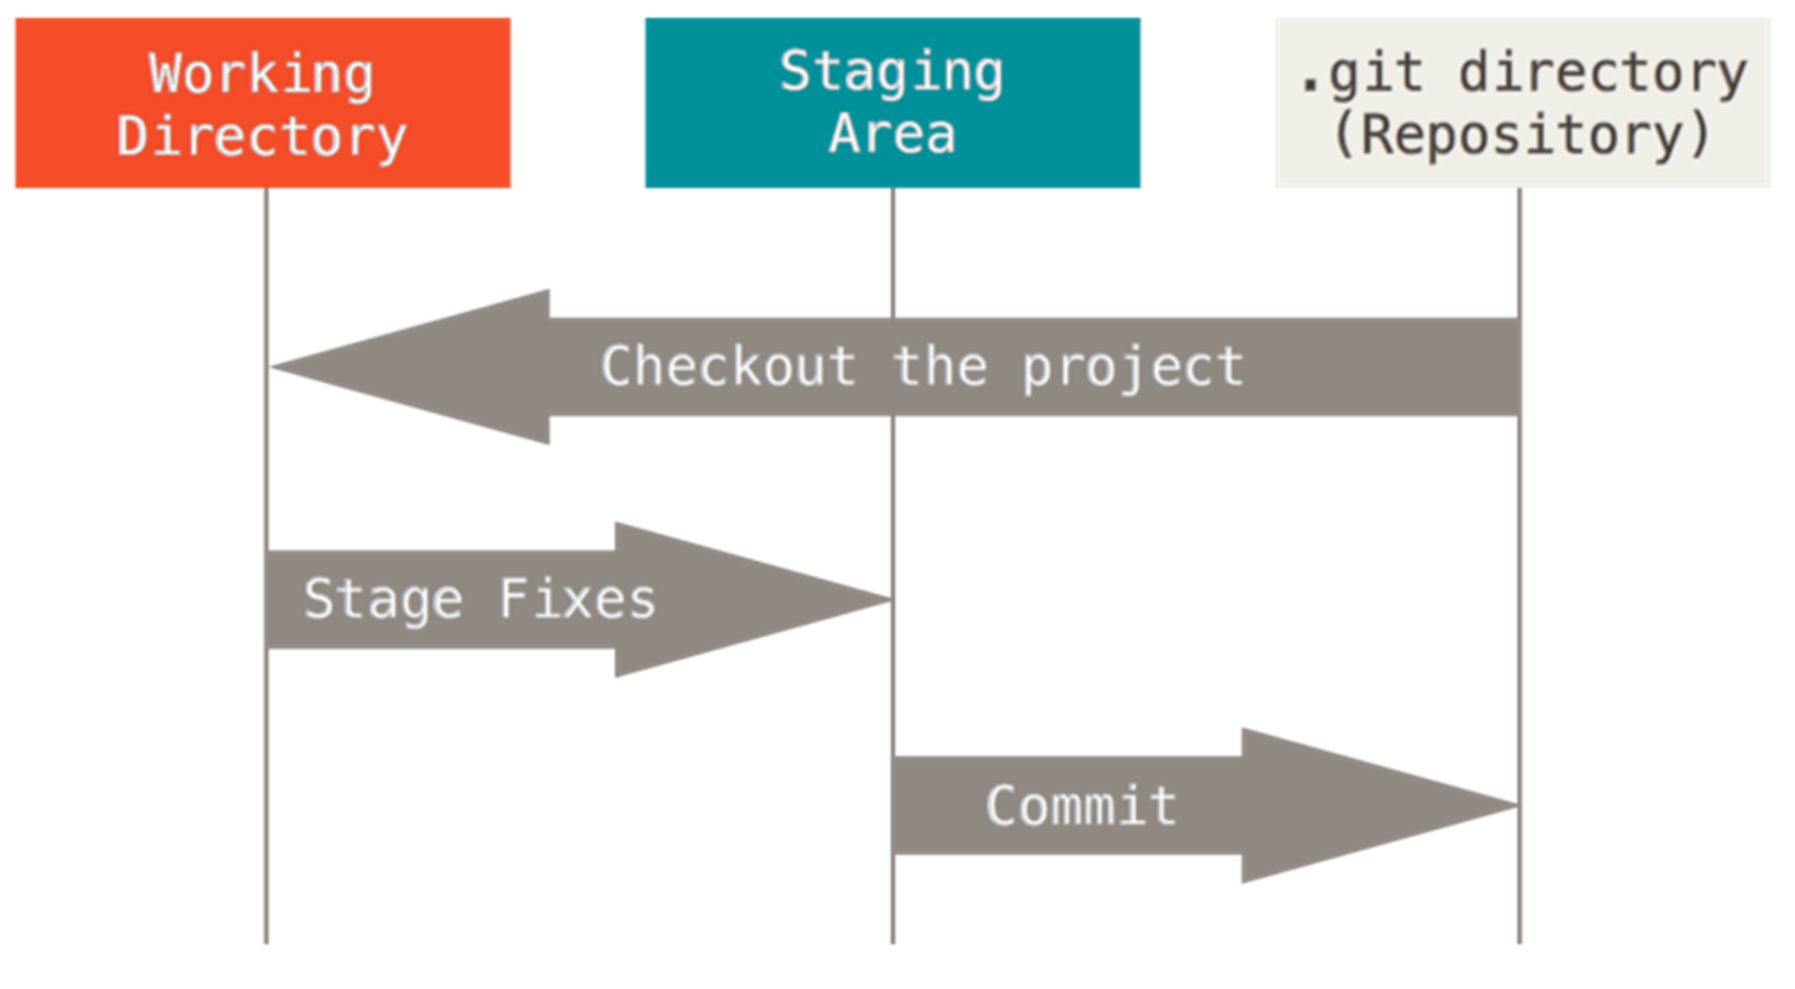
Before Starting
Local first
The Three States
Modified [ you have not committed it to repository yet ]
Staged [ you have to go into your next commit snapshot ]
Committed [ the data is safely stored in your local database ]
Notes:
The working tree is a single checkout of one version of the project.
The staging area is a file, generally contained in your Git directory, that stores information about what will go into your next commit.

Slide 7
Configuration
System Level
Global Level
git config
Local Level
Notes:
Git looks for the .gitconfig file in the $HOME directory (C:\Users\$USER for most people). It also still looks for [path]/etc/gitconfig
System Level (When we install) These setting can be overwritten according to user perspectives
Global: User Level Settings
Local : Repository Level Settings
git config –global user.name “YourName”
git config –global user.email “Email Address” git config --global core.editor “code” git config –global –list
git config –global –e [Lanch Default Code editor]

Slide 8
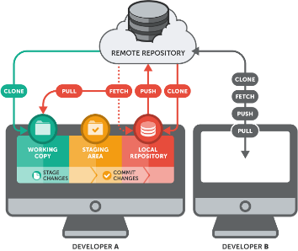
Environment
Installing Tools
Git-SCM
Gitforwindows
Git Chocolaty Package
Visual Studio, Visual Studio Code, PowerShell
Create Git Repository OR local directory that is currently not under version control
git init
Clone a project: Clone your project from remote server
git clone [remote repo url]
Introduce yourself to Git
git config
Notes:
git help <verb> | git <verb> --help
git remote add origin

Slide 9

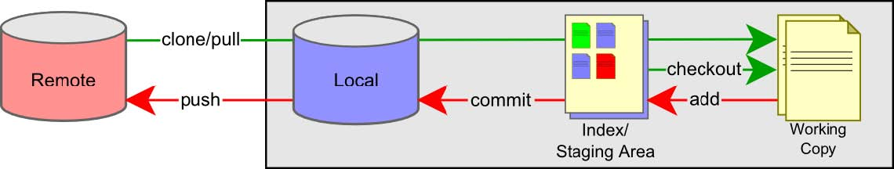
Before Starting
Notes:
(--staged and --cached are synonyms)

Slide 10
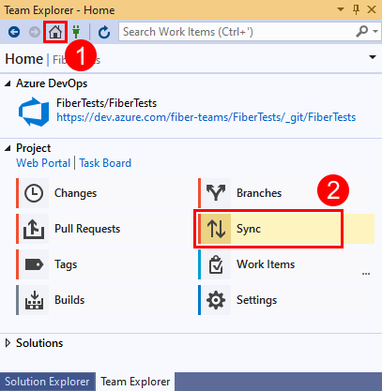
Environment
Open Visual Studio.
Click on Team Explorer.
Click on manage connection.
Click on Add Azure Devops server.
Enter Server URL and click on Add.
Click on your Git Project.
Enter the path where you want to clone your project and click on clone.
Wait it will take some time to get Git project on local machine.

Slide 11
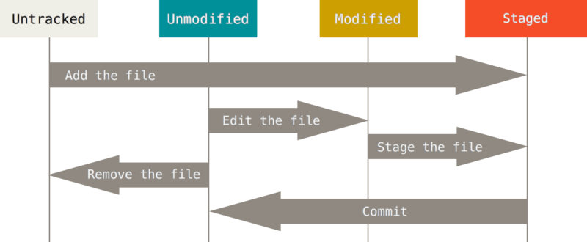
How Changes record?

Slide 12
How Changes record?
Click on Home button in Team Explorer.
Click on Branches.
Expend remote/origin.
Right Click on feature Branch and checkout
Create your local branch [feature_yourname/JIRATicketNo]
tracked - a file which has been previously staged or committed;
untracked - a file which has not been staged or committed; or
ignored - a file which Git has been explicitly told to ignore.
The git status [inspecting your repo] command can be used to obtain a summary of which files have changes that are staged for the next commit.
Notes:
git status

Slide 13
Basics
Check the status of your files: git status
Track/Stage New Files with : git add [file name OR * for all files]
Unstage/Discard Changes from Working directory: git restore
Ignoring Files: cat .gitignore
Temporary files from your development environment, test outputs, and logs are all examples of files that you create but aren't part of your codebase. Customize which files Git tracks through the gitignore feature.
git commit –m “message”
A commit in a git repository records a snapshot of all the (tracked) files in your directory.
Git also maintains a history of which commits were made when. That's why most commits have ancestor commits above them.
How to skip staging area: git commit –a –m “message”
Rename OR move the files: git mv old_filename New_FileName
To see what you haved changed with: git diff
Notes:
If you rename a file in Git, no metadata is stored in Git that tells it you renamed the file.
If you want to see what you’ve staged that will go into your next commit, you can use git diff --staged.
fsutil file createnew C:\Users\anees\myrepo\.gitignore 0
https://docs.microsoft.com/en-us/azure/devops/repos/git/ignore-files?view=azure-devops&tabs=visual-studio
https://www.atlassian.com/git/tutorials/saving-changes/gitignore
http://itportal:8080/tfs/DefaultCollection/DevOps/_git/solution2?path=%2Fvisualstudio.gitignore&version=GBmaster&_a=contents
Visual Studio Ext VSCcommitizen

Slide 14
Thank you

